Slide 1
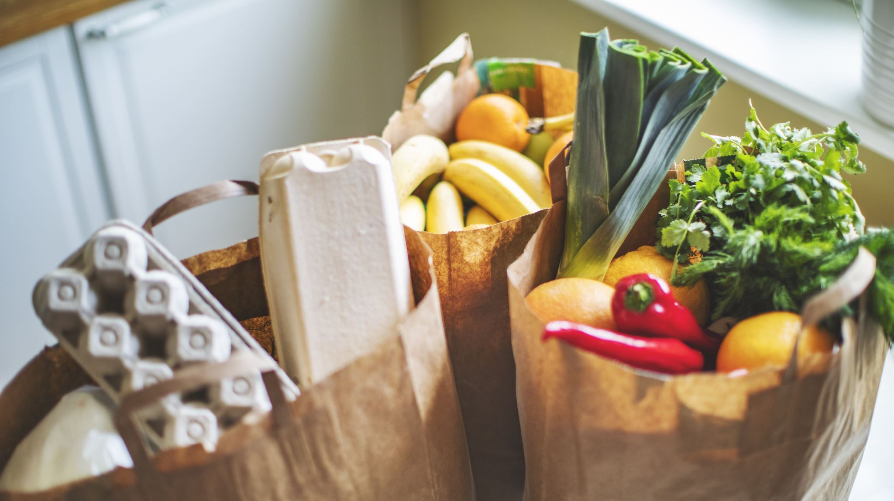
HOMELY FOOD DELIVERY SYSTEM
Dona Jacob(25)
Hala P(32)
Nanditha P(49)
Shana Sherin M(57)

Slide 2
CONTENTS
Problem statement
Objectives
Literature Review
Motivation
Project plan

Slide 3
PROBLEM STATEMENT
Regular consumption of junk foods can lead to several health problems, including obesity, diabetes, heart diseases, and high blood pressure.
Unavailability of food delivery services in remote areas while travelling
Unemployed homemakers- feelings of financial insecurity and low self-esteem

Slide 4
OBJECTIVES
Our objective is to make a mobile application which aims at:
Providing healthy and nutritious food options for travelers to ensure they have access to meals that meet their specific dietary requirements and preferences.
Building partnerships with local food suppliers, farmers, and distributors to source fresh and high-quality ingredients for healthy food options in remote areas.
Expanding the reach of the food delivery service to cover a wide range of locations, catering to the needs of travelers across different regions and destinations.
Provide homely meals to people with health issues considering their dietary requirements.

Slide 5
For home-makers
Employment opportunities
Flexibility
Income generation
Skill development
Empowerment

Slide 6
LITERATURE REVIEW
Many travelers face difficulties in finding nutritious and hygienic food options while travelling, particularly in remote areas. This can lead to health issues, including foodborne illnesses, and can have a negative impact on the travel experience.
Several studies have highlighted the importance of providing healthy food options for travelers. For instance, a study by Garud and Raghavendra (2017) found that travelers often face difficulties in finding healthy food options while travelling, particularly in developing countries. The study suggested that there is a need for more healthy and hygienic food options for travelers, particularly in remote areas.

Slide 7
LITERATURE REVIEW
A study by de Groot et al. (2017) found that healthy eating habits can have a significant impact on the health outcomes of aged people. The study suggested that providing access to healthy food options can help to prevent chronic diseases, improve mental health, and enhance quality of life for aged people.
Another study by Ruggiero et al. (2018) highlighted the importance of providing healthy food options for patients with chronic diseases. The study found that nutrition plays a critical role in managing chronic diseases such as diabetes, heart disease, and cancer. The study suggested that providing access to healthy food options can help to improve the health outcomes of patients with chronic diseases.

Slide 8
MOTIVATION
We aim to provide a reliable and convenient solution to these problems by offering homely and healthy food options through food delivery services.
By doing so, we hope to improve the overall health outcomes, wellbeing, and quality of life for travelers, aged people, and patients.
Additionally, our project aims to provide employment opportunities for unemployed homemakers and promote healthy eating habits in the community.

Slide 9

PROJECT PLAN
MODULES
Home-maker module
User module
Food-menu module
Order module
Food-prediction module

Slide 10
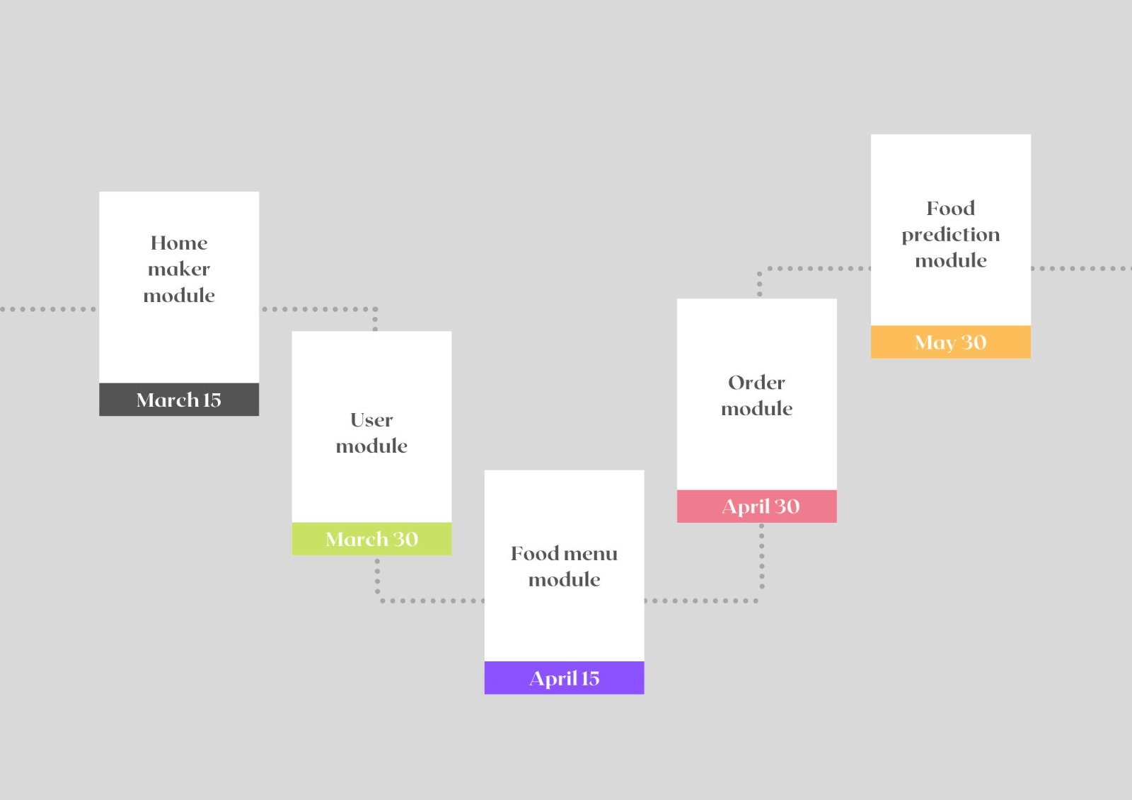

Slide 11
THANK YOU

